Slide 1
Actionscript 3.0 Basics
8 – Patterns

Slide 2
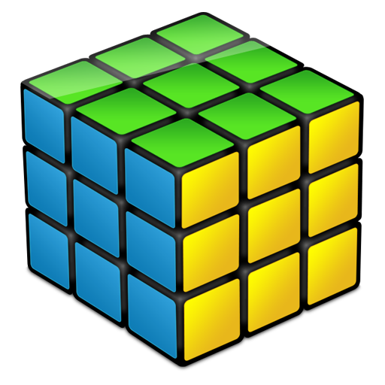
Patterns
In software engineering, a pattern is a
general reusable solution to
a commonly occurring problem
that can be transformed directly into code.
It is a description or template
for how to solve a problem that can
be used in many different situations.

Slide 3
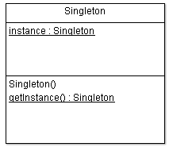
Singleton
The singleton pattern is used to implement
the mathematical concept of a singleton,
by restricting the instantiation
of a class to one object.
Advantages:
- Single point of control
- Global Access

Slide 4
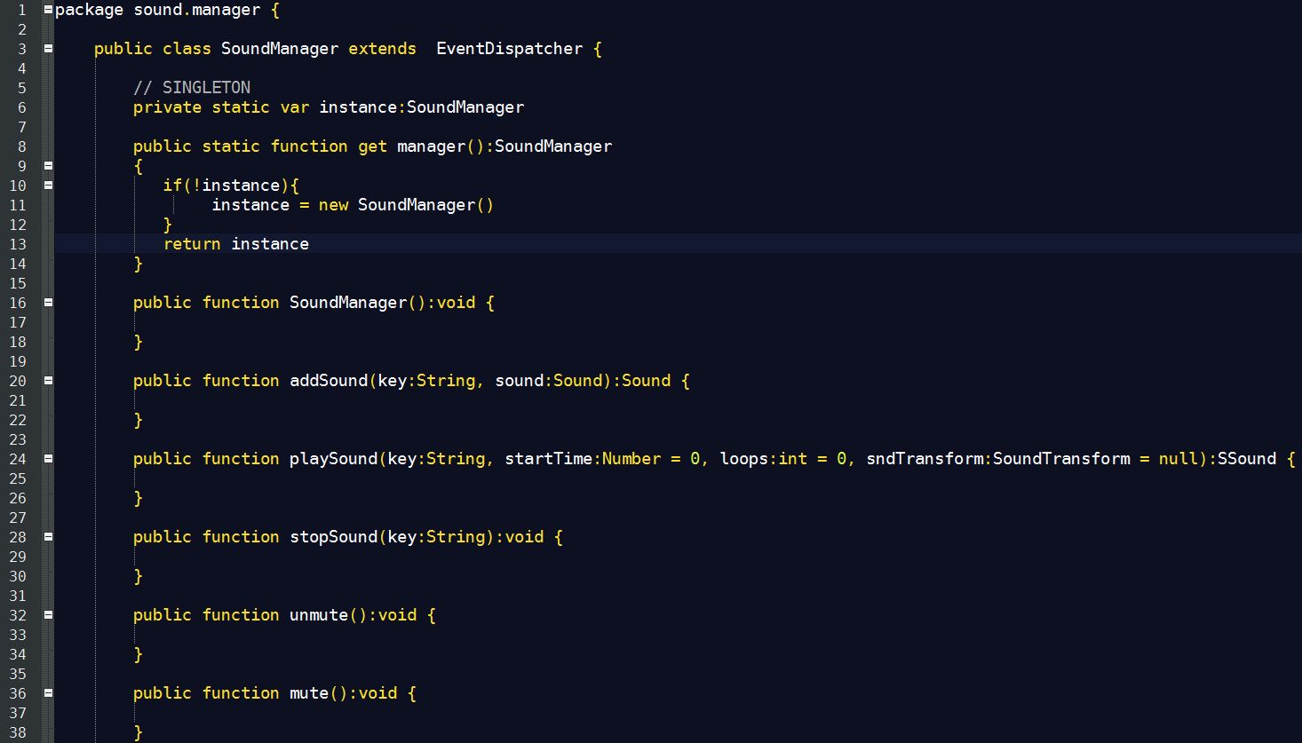
Singleton: Managers
Example: Sound Manager

Slide 5
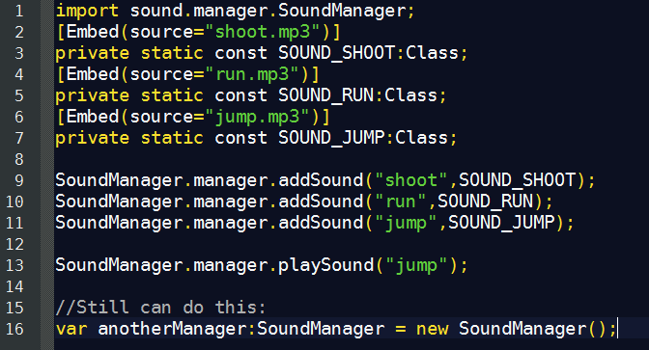
Singleton: Managers
Example: Sound Manager Usage

Slide 6
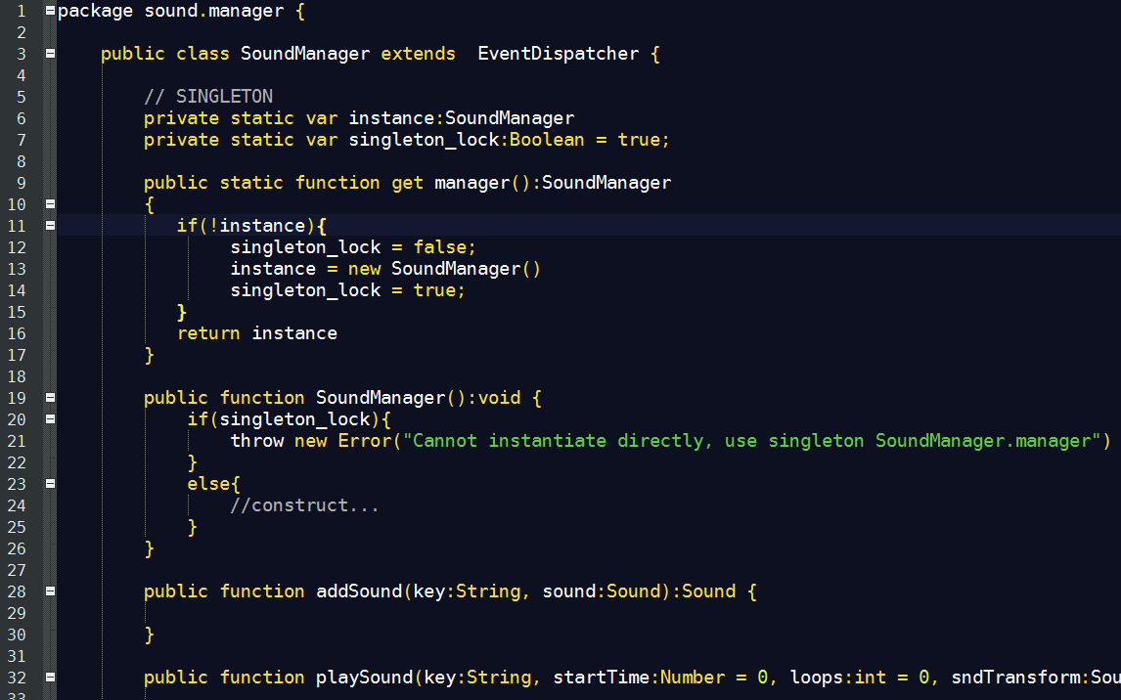
Singleton: Managers
Strict Singleton:

Slide 7
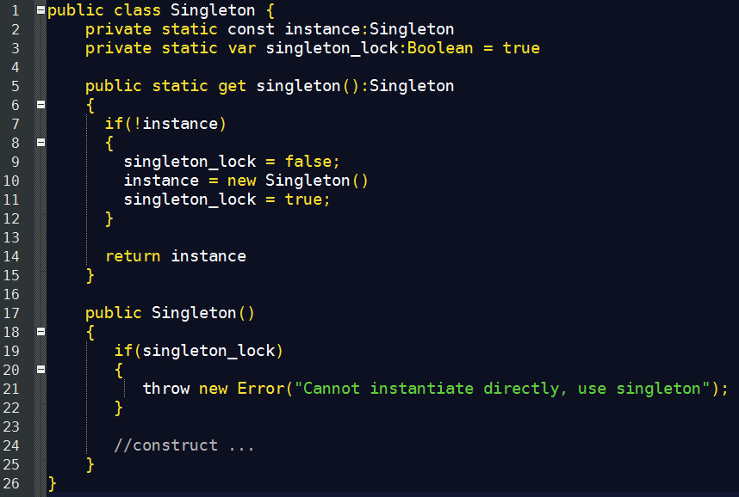
Singleton
General code:

Slide 8

Singleton
Some people consider Singleton as an anti-pattern.
Reasons:
- Introduces Global Environments
- Promotes bad design practices when abused.
- Most of the time “singletonised” objects are not actually required to be unique.
Example:
Why is SoundManager a singleton?
Can we have a SoundManager per layer?
Can we have a SoundManager per level?

Slide 9
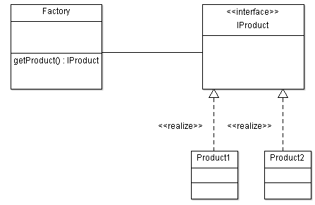
Factory
A factory is an object for creating other objects.
It is an abstraction of a constructor, and can be used to implement various allocation schemes.

Slide 10
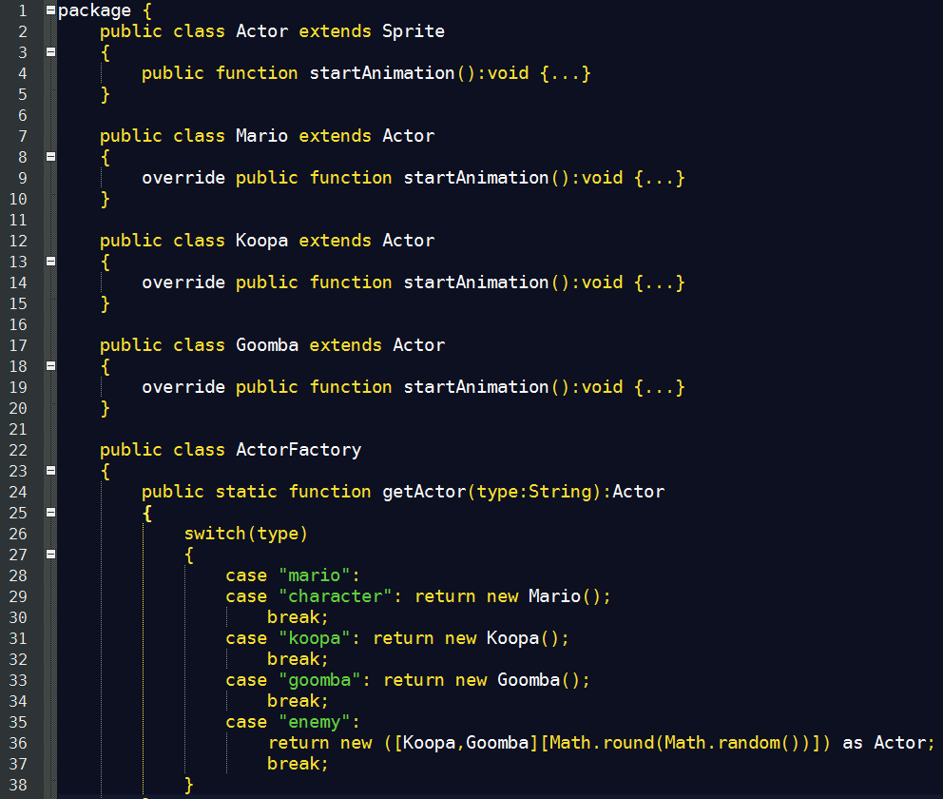
Factory: Asset Factory
Simple Asset Factory

Slide 11
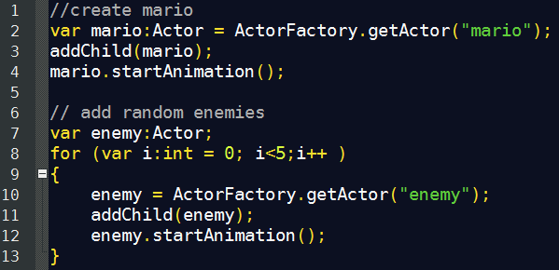
Factory: Asset Factory
Simple Asset Factory Usage

Slide 12
Pool
A pool is a use case of the Factory Pattern.
It is used mainly for object lazy instantiation and
re-utilization.

Slide 13
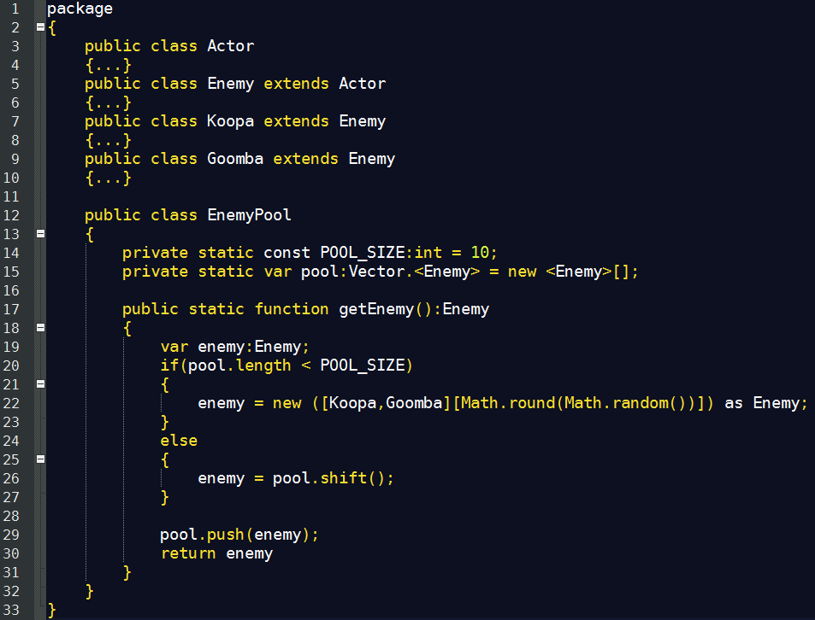
Pool: Asset Pool
Simple asset pool:

Slide 14
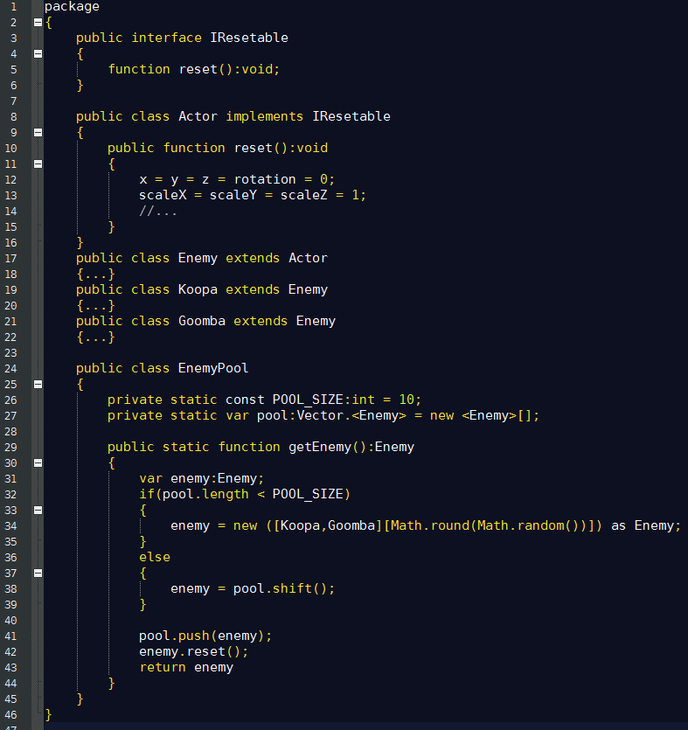
Pool: Asset Pool
Resetable Assets:

Slide 15
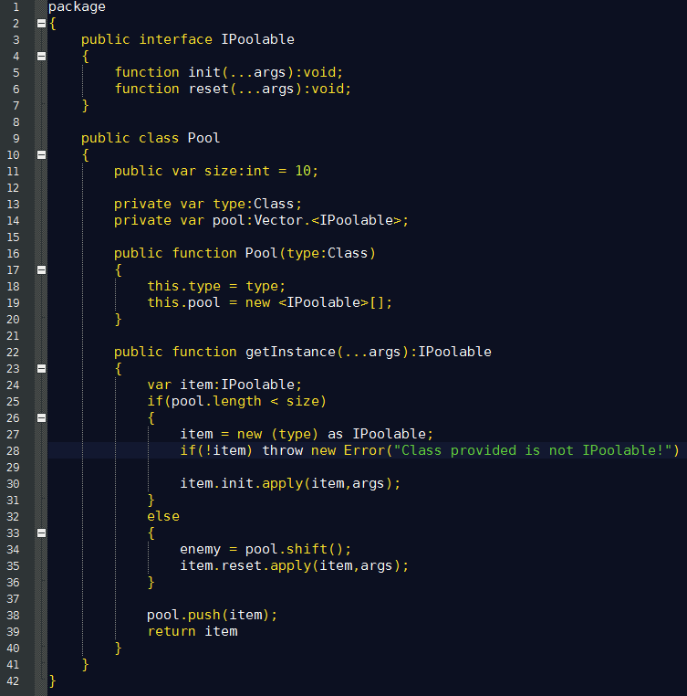
Pool: General Purpose Pool

Slide 16
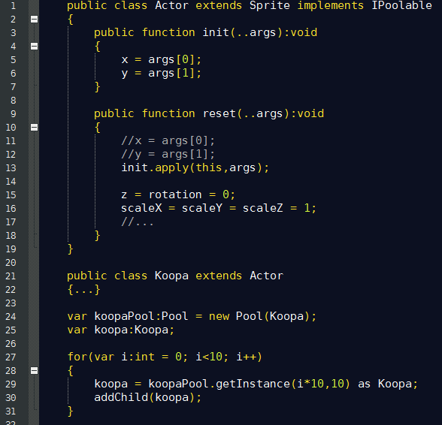
Pool: General Purpose Pool

Slide 17
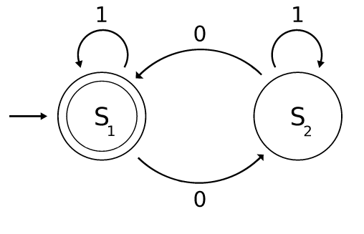
State Machines
A state machine, is a behavioral model used to design computer programs.
It is composed of a finite number of states associated to transitions. A transition is a set of actions that starts from one state and ends in another (or the same) state. A transition is started by a trigger, and a trigger can be an event or a condition.

Slide 18
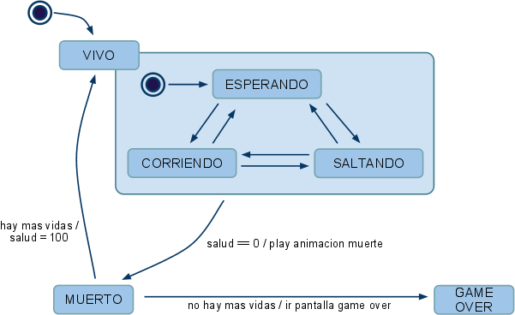
State Machines

Slide 19
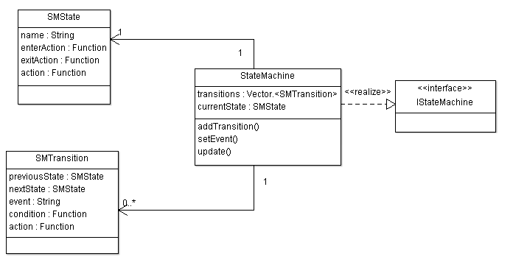
State Machines

Slide 20
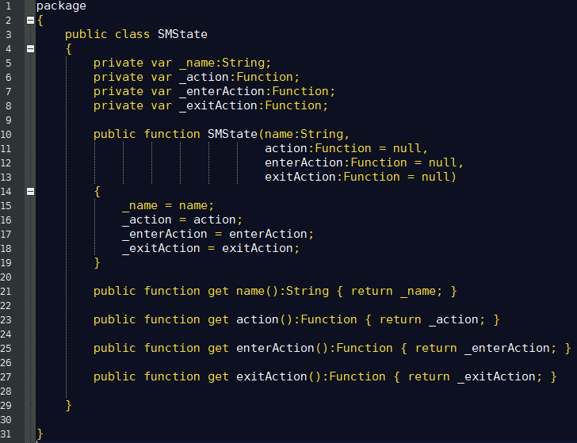
State Machines: State

Slide 21
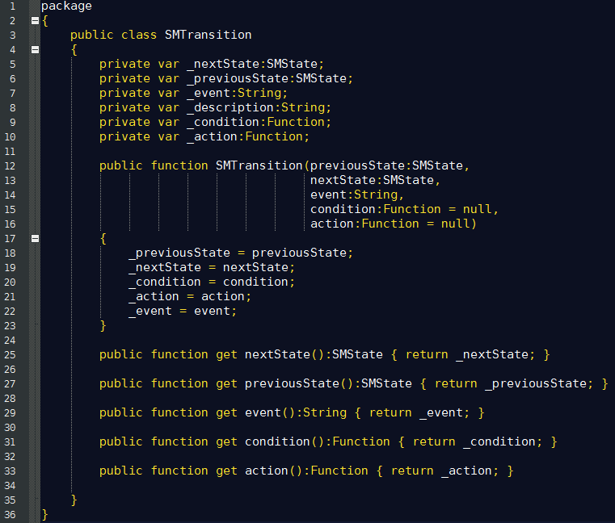
State Machines: Transition

Slide 22
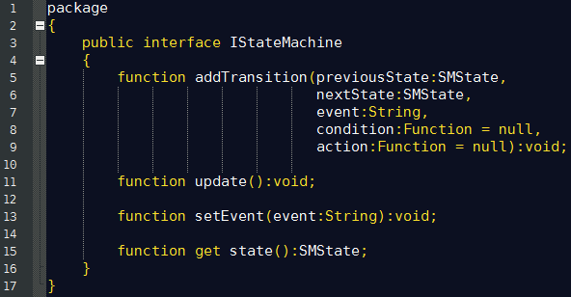
State Machines: Machine

Slide 23
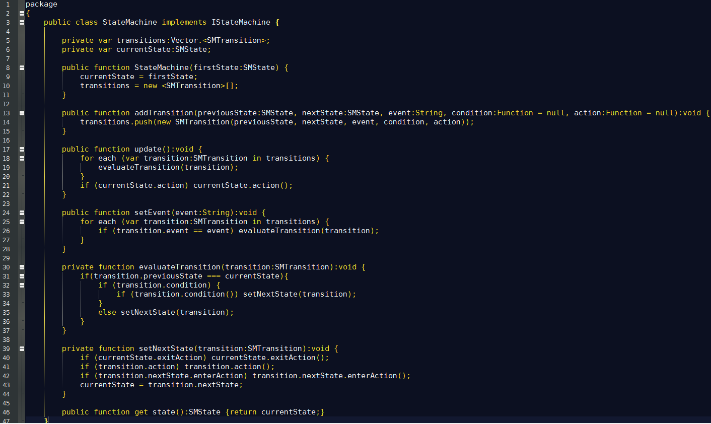
State Machines: Machine

Slide 24
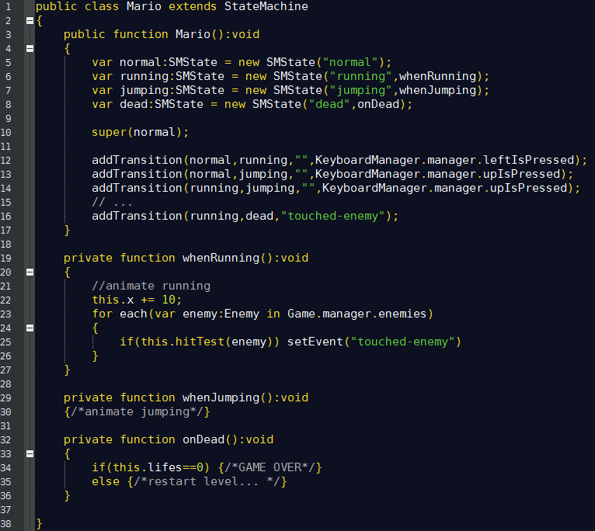
State Machines

Slide 25
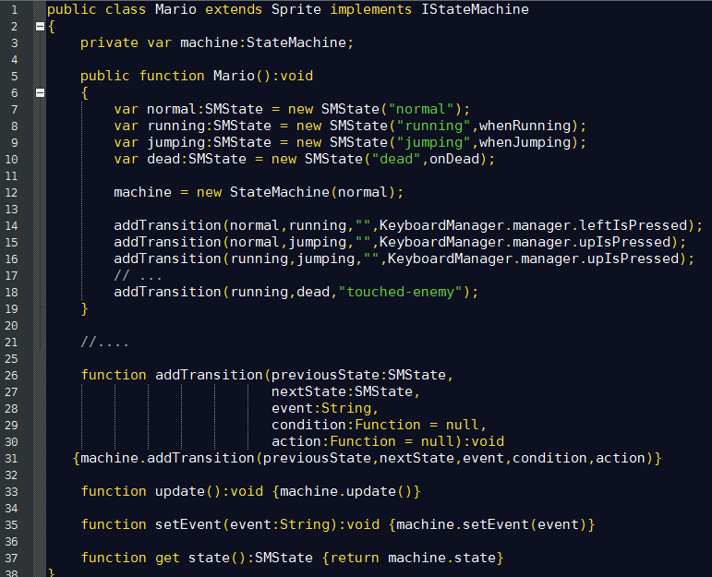
State Machines
On display Objects:

Slide 26
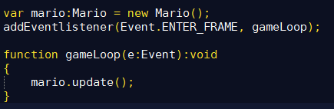
State Machines
Add to main loop:

Slide 27
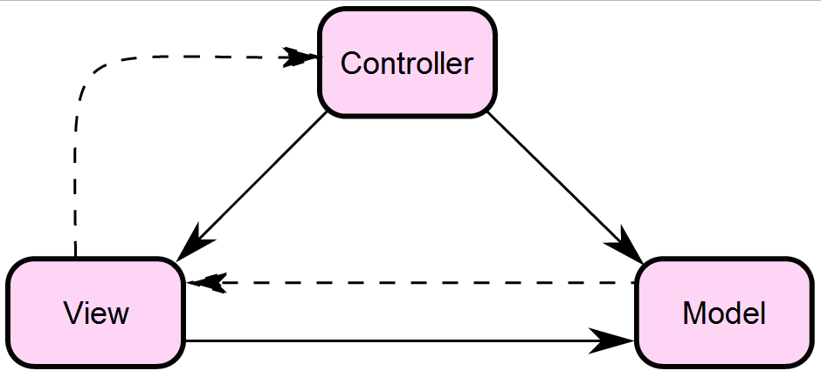
Model-View-Controller
MVC is an architectural pattern that isolates "domain logic" from the user interface (input and presentation), permitting independent development, testing and maintenance of each (separation of concerns).

Slide 28
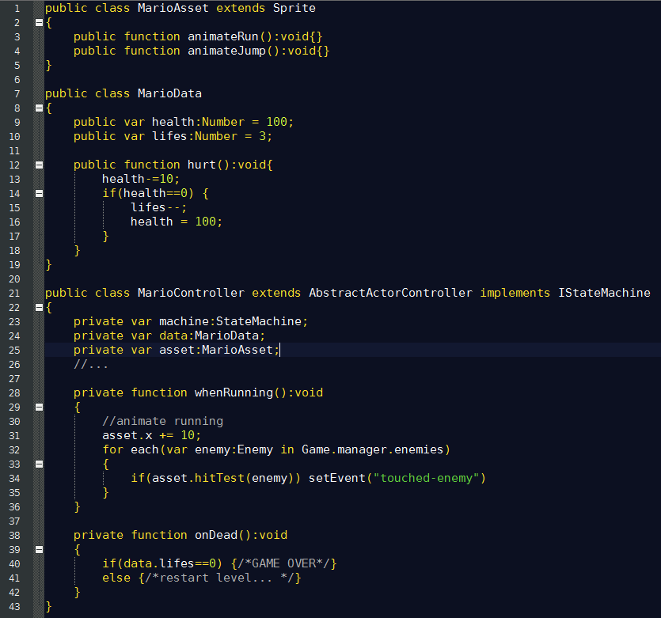
Model-View-Controller

Slide 29
Generally...
KISS
Keep It Simple & Stupid
COC
Convention Over Configuration
DRY
Don't Repeat Yourself

Slide 30
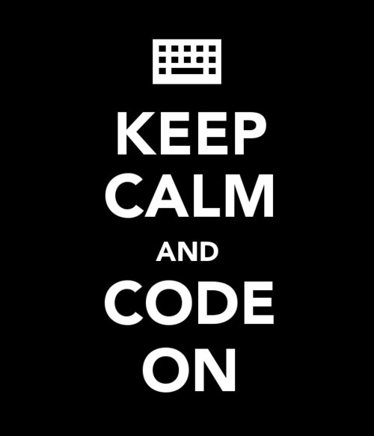

Slide 31
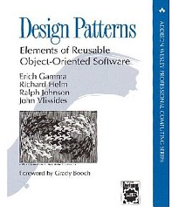
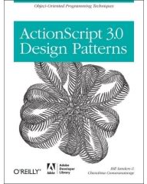
Read This!

Slide 32

Thanks!
github.com/matix/as3basics
matias.figueroa@globant.com
@matixfigueroa

